Slide 1
System panic week 3
Aleksander m.
Antony p.
Layla h.

Slide 2
Changes
Changed the look of the dungeons
Added lighting and updated intersections
3 Enemies were added into the game
Character Animations
Code Refactor and changing attributes

Slide 3
GENERATION

Slide 4


Slide 5
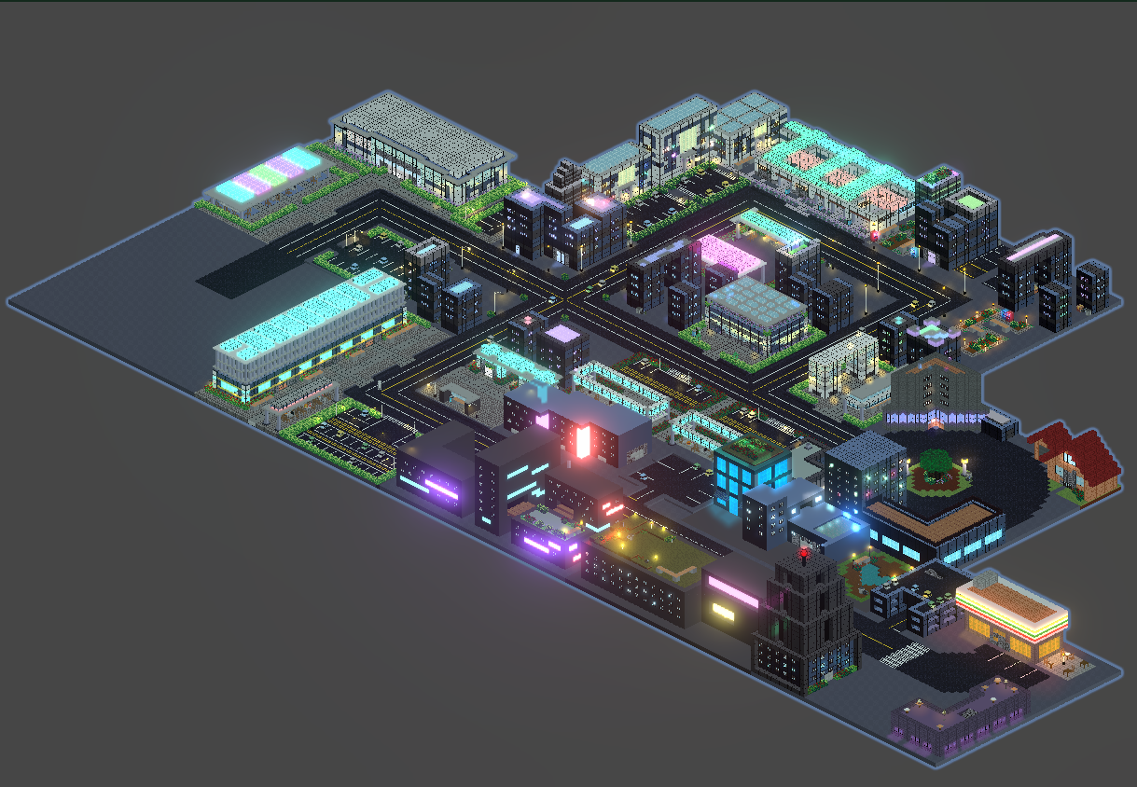
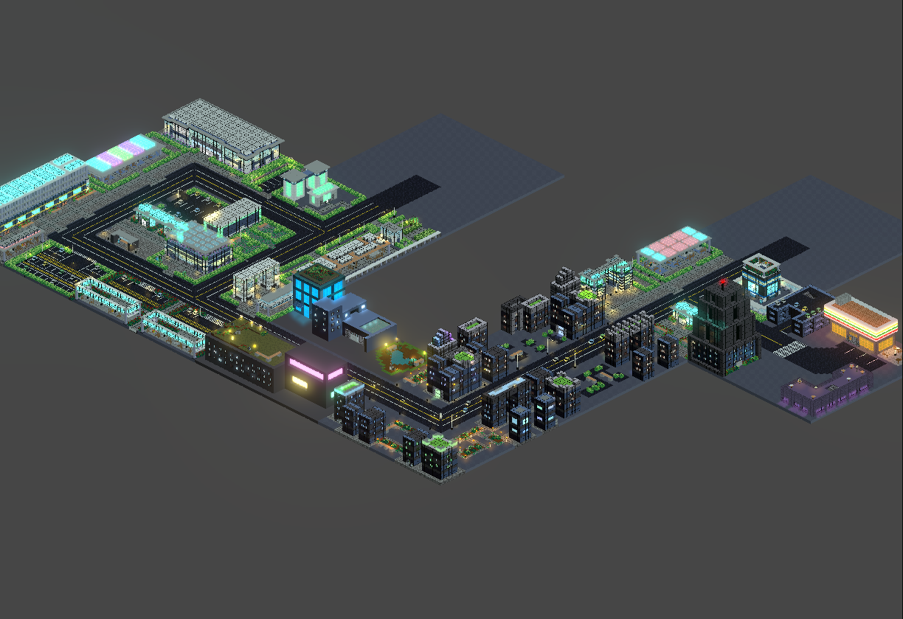

Slide 6
In-game

Slide 7
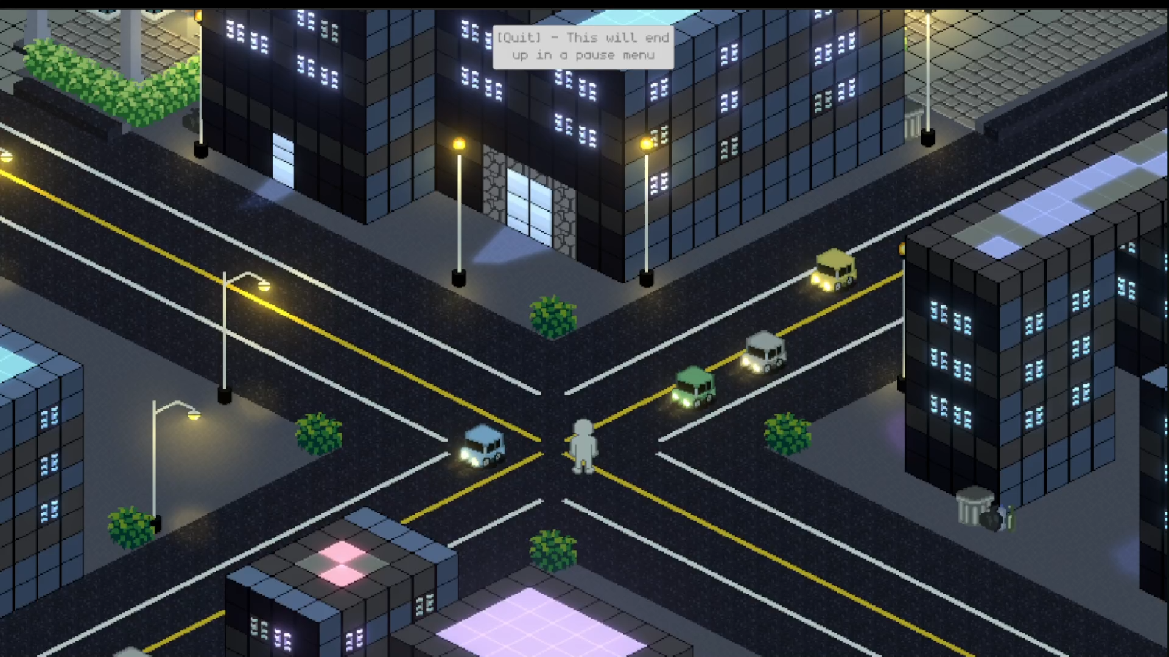

Slide 8
new intersections

Slide 9
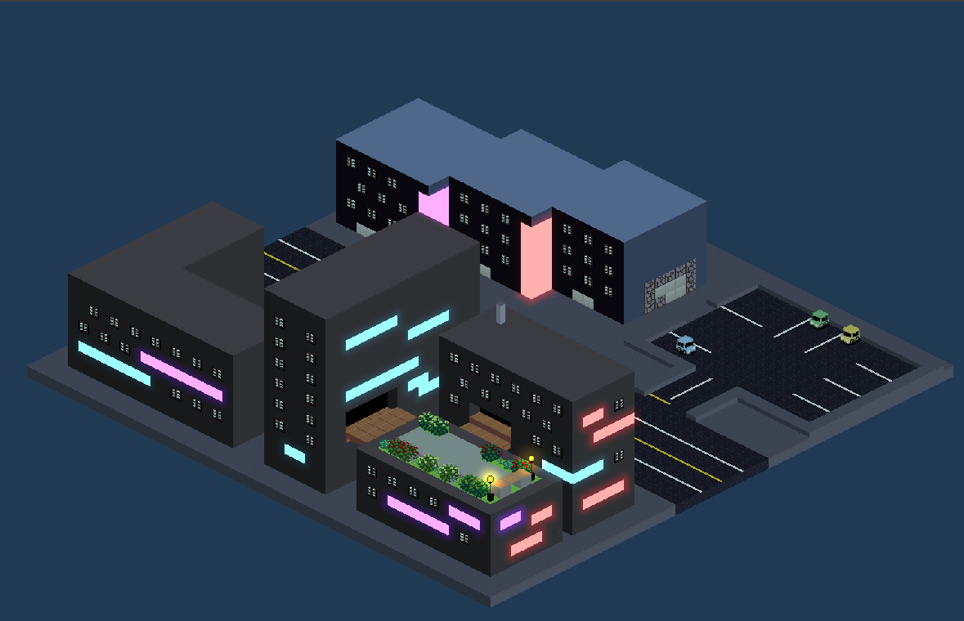
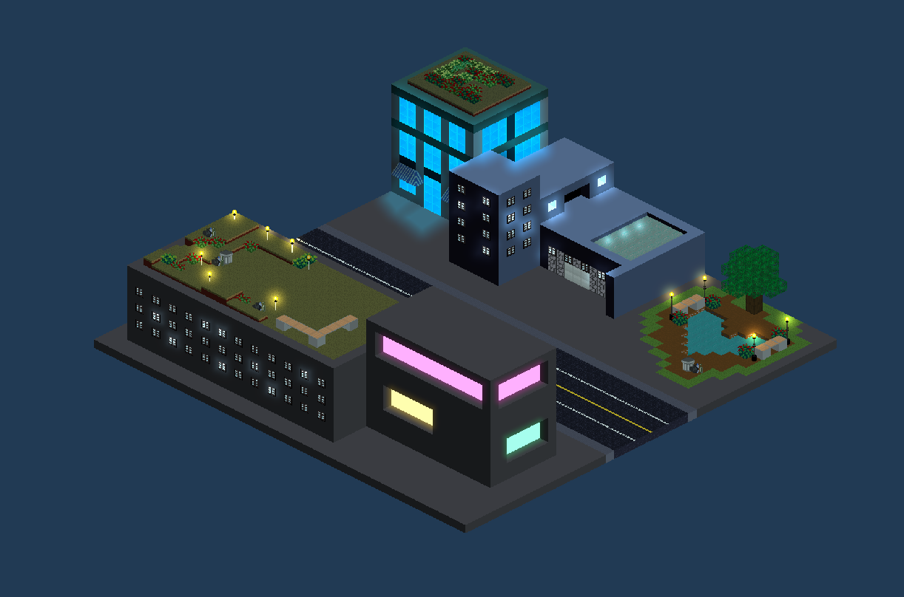
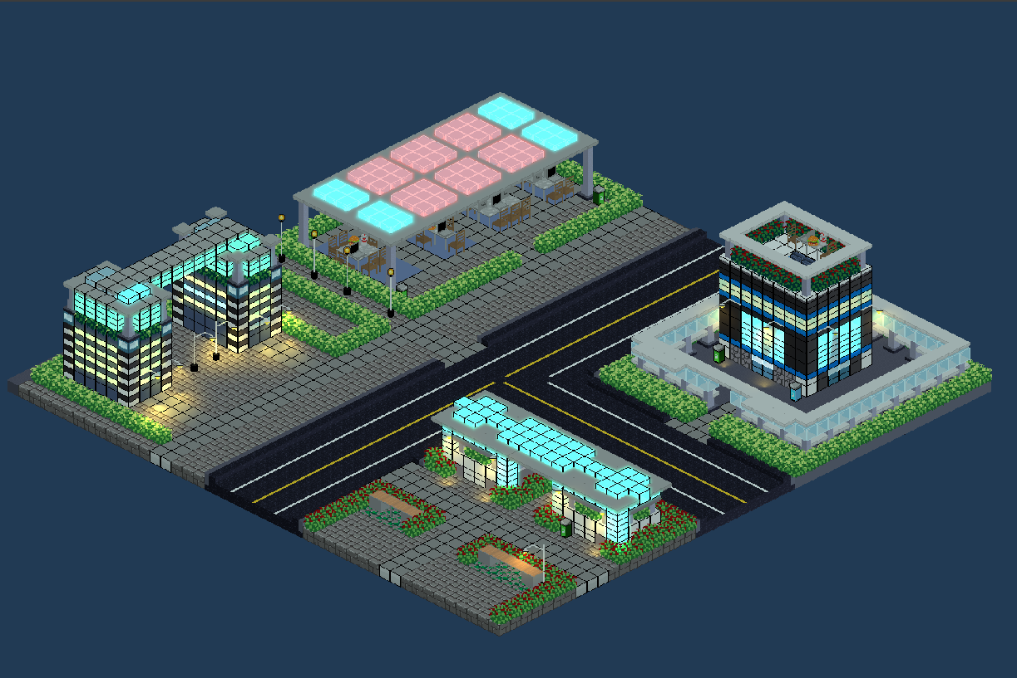
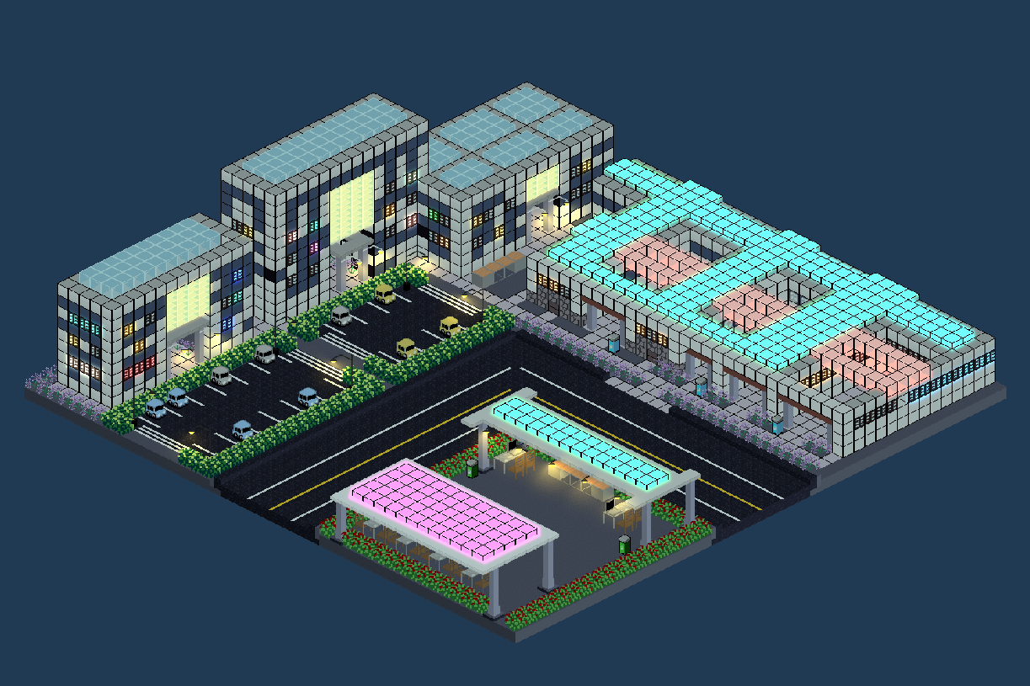

Slide 10
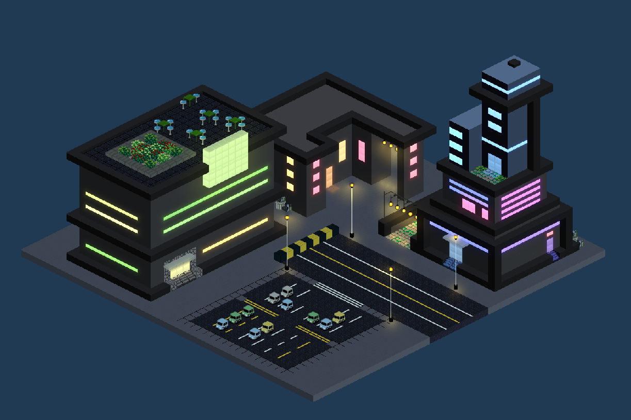
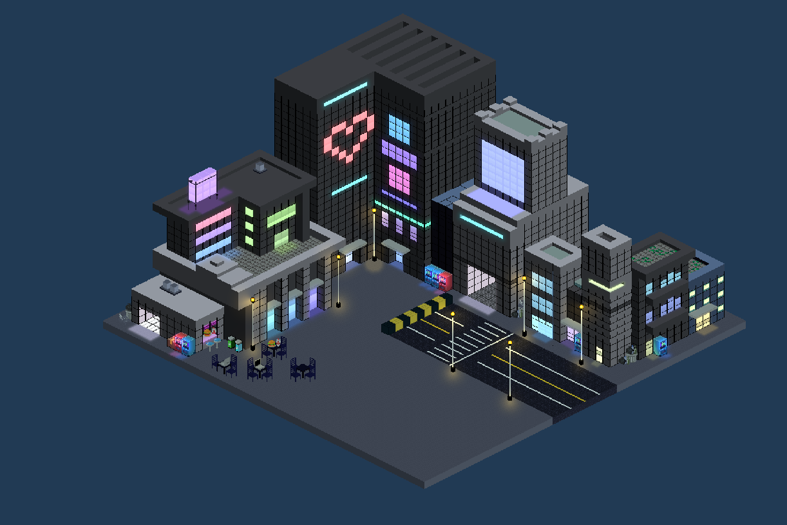
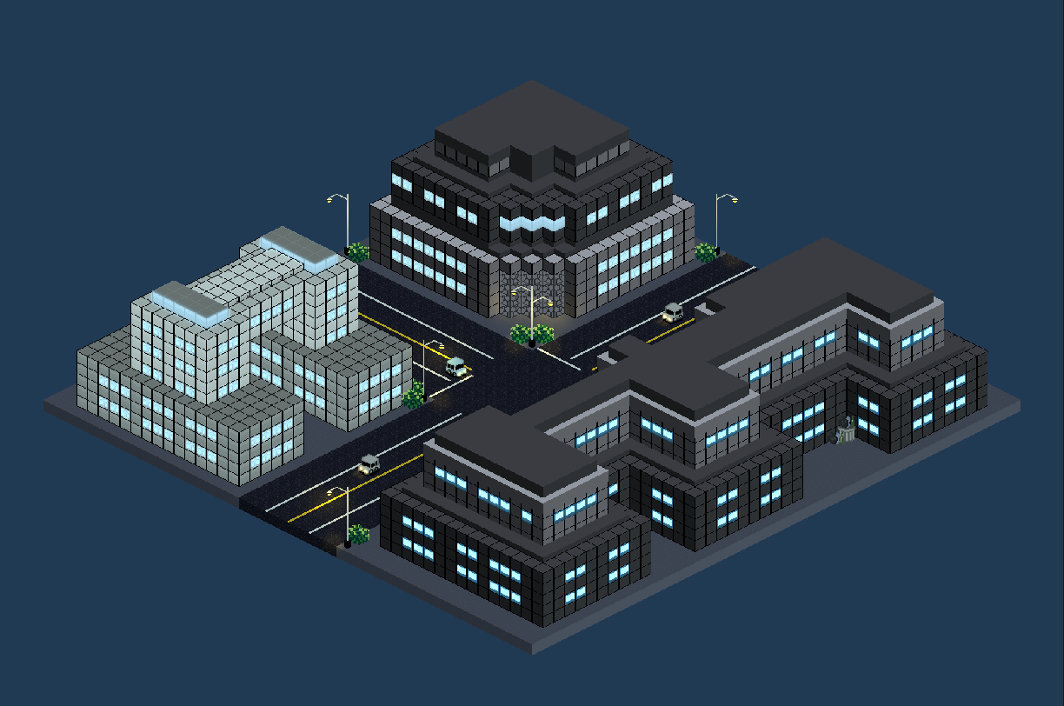
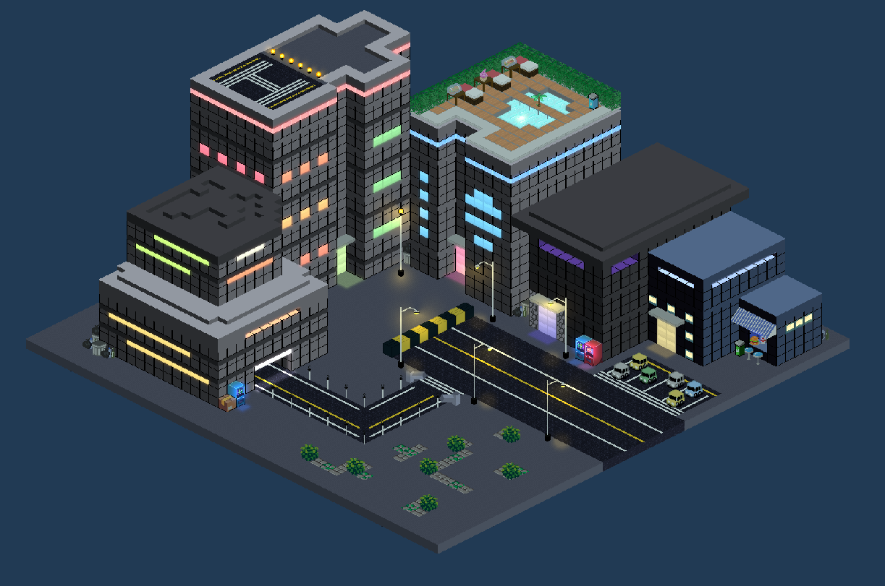

Slide 11
dungeons

Slide 12
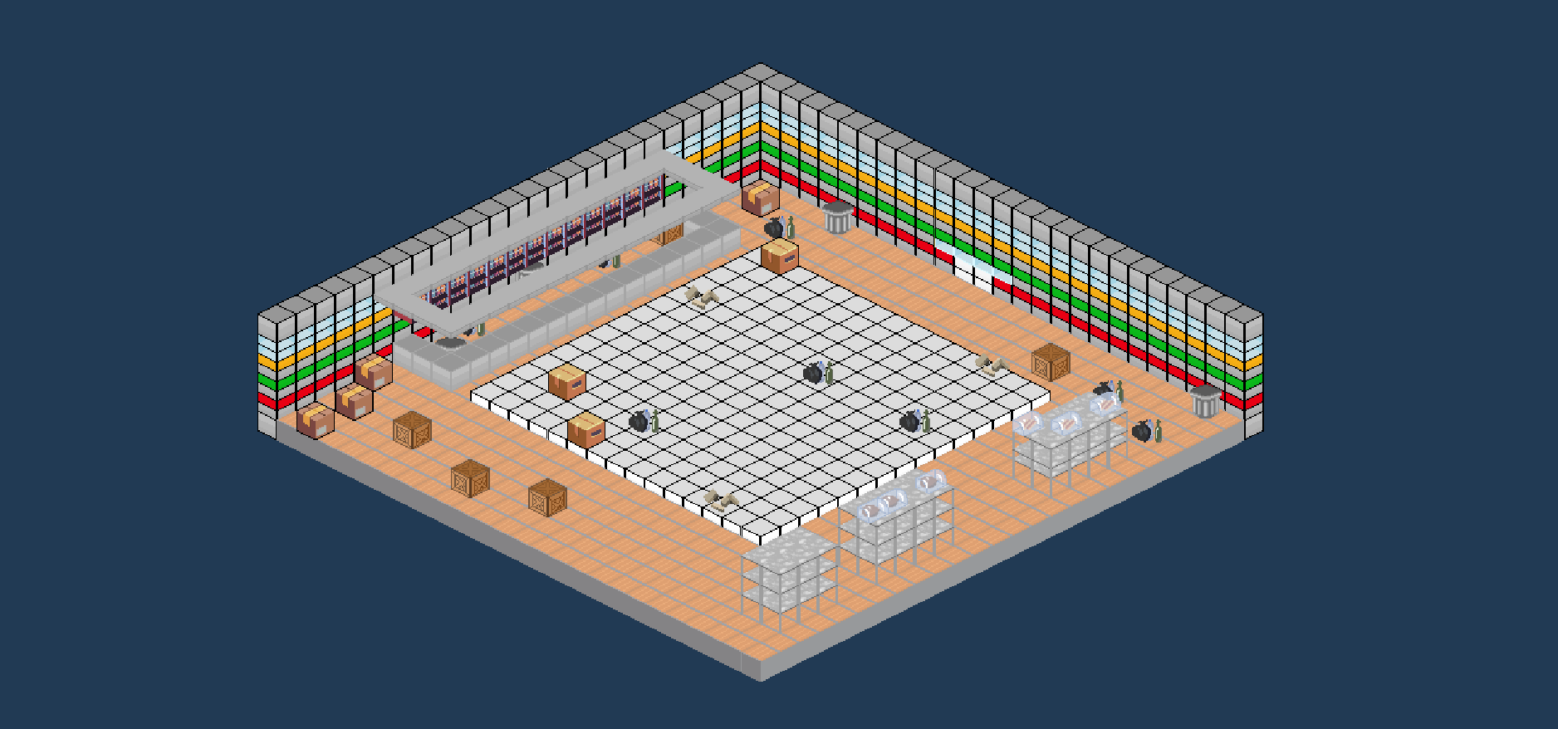
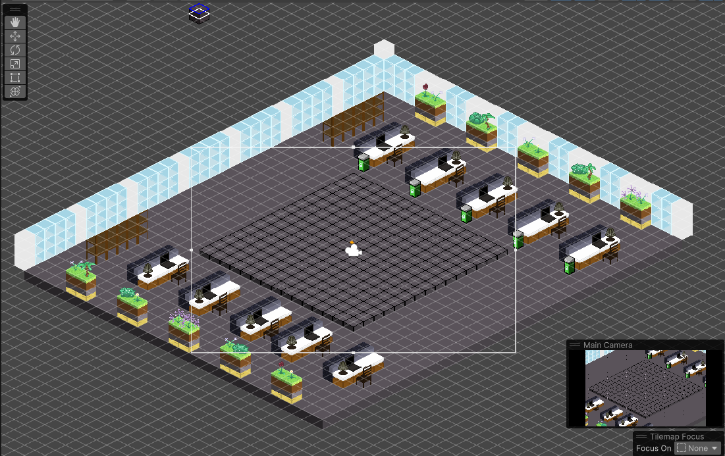
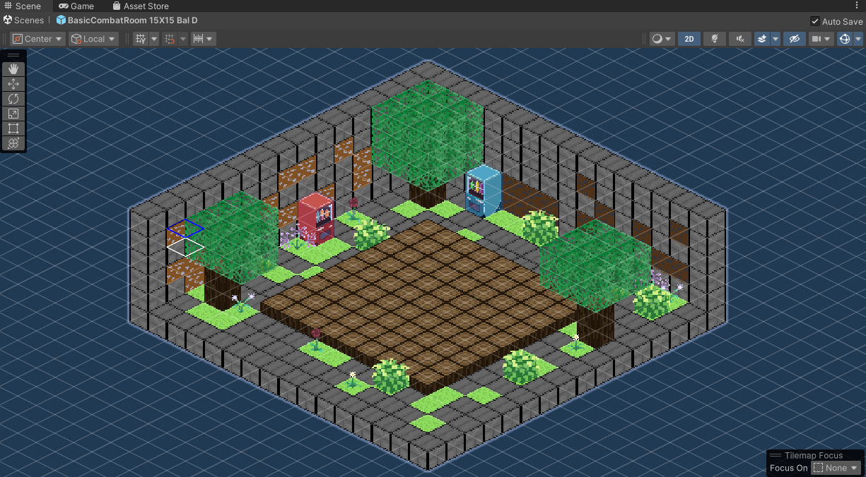

Slide 13
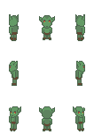
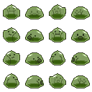
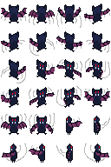
Enemies

Slide 14
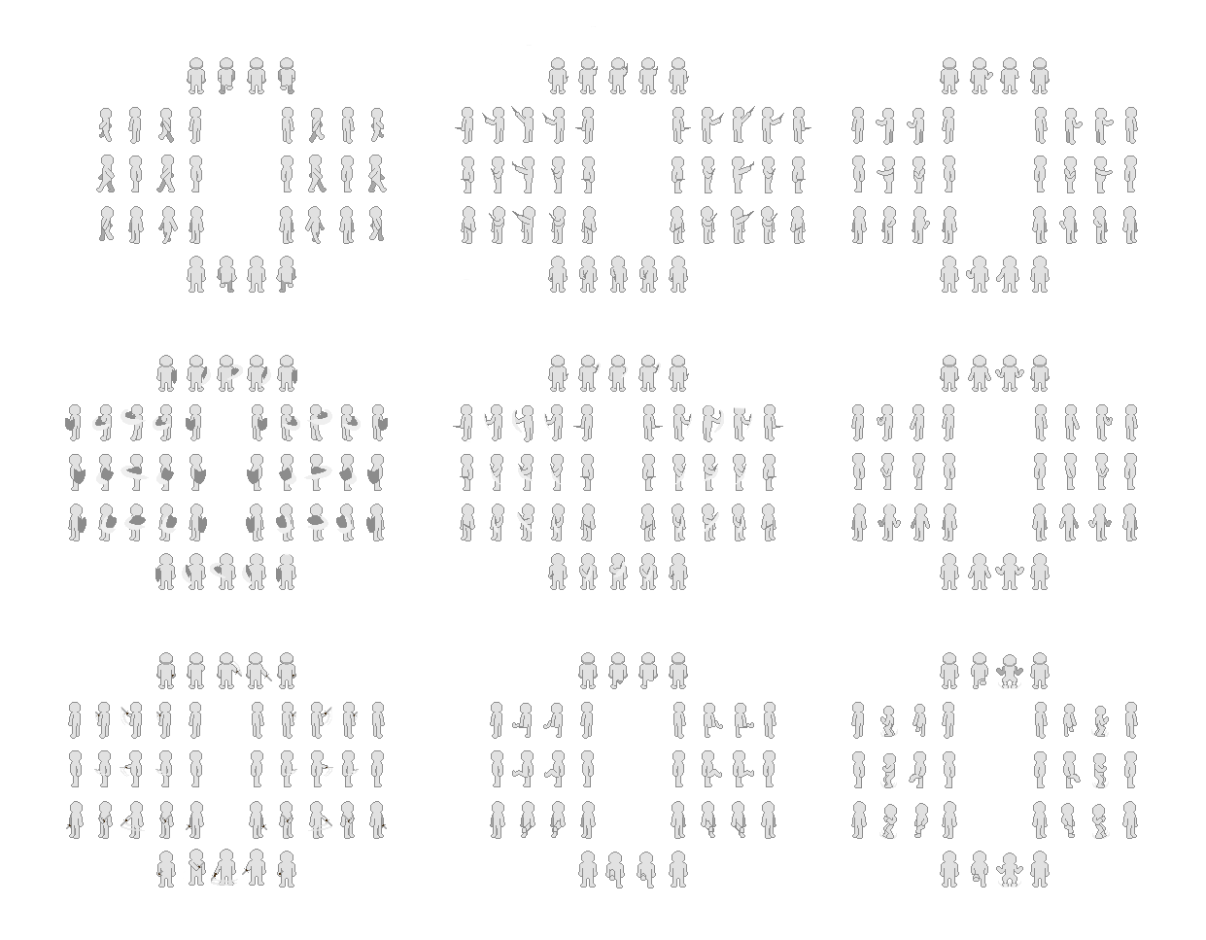
Character Animations
Fixed Walk
Wand
Spell Cast
Next week we are going to finalize all the animations for the character and add on the armor and weapons for each class
Shield Bash
Dagger Swing
Berserk
Sword Swing
Kick
Ground Slam

Slide 15
Code Refactor and Attribute Upgrades
We have also finished a refactoring of our code that will make adding new systems and building on what we have faster and much easier. Player can also now increase their attributes and for this sprint(two weeks) we are planning on getting a leveling system done. Using the new refactored system we will be polishing combat and ensuring that the player can use items and abilities.

Slide 16
What to expect

